Slide 1

Database Project Final Presentation Fantasy Football Manager
PRESENTED BY
ANDREW PERRONE - 1315988
SRI SAKTICHARAN - 1337576
AQIB AHSAN – 1333611

Slide 2

Problem:
In Fantasy Premier League, there is a need for a robust and efficient SQL database to store and manage player data, team information, and match statistics. This database will serve as the backbone of the fantasy game, allowing users to make informed decisions and track their team's performance.

Slide 3

Motivation:
Millions of people around the world play and enjoy watching football/soccer. Fantasy Football websites not only provide a fun way to engage with the sport but also provide the football fans with real world information on upcoming games. Centralizing data relevant to the league allows players to make better decisions on updating their fantasy teams according to the live performances of the players.

Slide 4

Applications
The SQL database can be used by both players and administrators:
Players can use the database to research players, analyze performance trends and make informed transfers and captaincy choices
Administrators can leverage the database to track user activity, and generate reports on game performance

Slide 5
Database Design & Implementation
ER Diagram
Schema
The ER diagram represents the entities and their relationships in the database. It includes entities such as 'Player', 'Team', 'Fixture', 'User', and 'League', along with their attributes and relationships.
Based on the ER diagram, we implemented certain schema for the Fantasy Premier League database
Data
SQL Statements
Records of the users, matches, teams and players
are stored.
We used SQL statements to achieve various tasks, such as:
•Inserting player data into the 'Player' table.
•Updating team information in the 'Team' table.
•Querying fixture data using SQL SELECT statements.
•Managing user data in the 'User' table.
•Handling league information in the 'League' table.

Slide 6
Schema
Based on the ER diagram, we implemented following schema for the Fantasy Premier League database
Season | season_id, startDate, endDate
fantasyLeague | fantasyleague_id, fantasyleague_name
UserTeamStats | UserTeamID, SeasonID, matches_played, wins, losses, goals, goals_conceded, clean_sheets
teamStats | team_id, season_id, matches_played, wins, losses, goals, goals_conceded, clean_sheets
league | league_id, league_name
userTeam | userteam_id, display_name, full_name, team_name, email, password, budget
team | team_id, team_name, league_id
fantasyLeagueMember | fantasyleague_id, fantasyleague_name

Slide 7
Schema Continued….
player | player_id, player_name, cost, pos, team_id, league_id
fantasyTeamMember | userteam_id, player_id, position
fixture | fixture_id, gameweek, fixture_date, location, league_id, season_id, home_team_id, home_team_goals, away_team_id, away_team_goals, draw.
Fantasyfixture | fixture_id, gameweek, fantasyleague_id, season_id, home_team_id, home_team_goals, away_team_id, away_team_goals, draw.
playerStats | player_id, season_id, apearances, wins, losses, goals, goals_conceded, assists, passes, crosses, blocked_shots, clearance, interception

Slide 8
ER Diagram

Slide 9
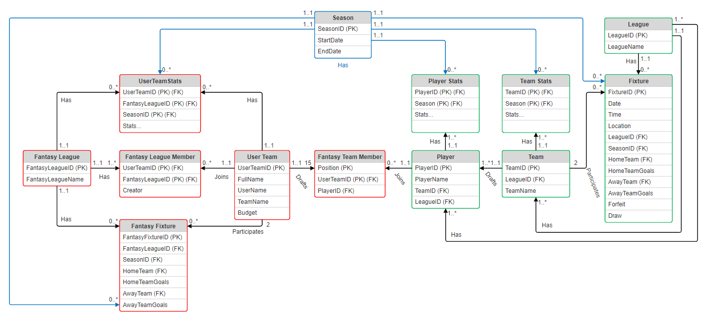

Slide 10
PROJECT DEMO
Player Data
Team Data
Fixture Data
League Data
Season Data

Slide 11
Conclusion
Main Contributions
What Worked
What Did Not Work
Created a SQL database for Fantasy Premier League data
Created the functionality to run and record user data interactions
Fixtures can be run
Users’ stats update after a fixture is run
SQL queries and views function correctly
We were unable to combine the “real” relations and the “fantasy” relations into one
We were unable to automate the collection or creation processes for the data
The fantasy portion of the database is still missing functionality

Slide 12
Considerations for future:
Automatically extract all the relevant data from the fantasy premier league API
Automatically generate “dummy” user data
Better simulate fixtures
More functionality for the user functions (creation of user, creation of league, draft players, etc.)
Need more processes to maintain data integrity (a custom constraint is needed to prevent users’ teams from having duplicate players, etc.)

Slide 13

THANK YOU!

